Slide 1


Team 4
presents
ScoutMaster
Ayush Sengupta
Donald Pendagast
Elilinma Ezeife
Nehal Azmat
Chandrashila

Slide 2


Agenda
01
Business case
02
New strategies
03
Soccer reporting
04
Summary

Slide 3
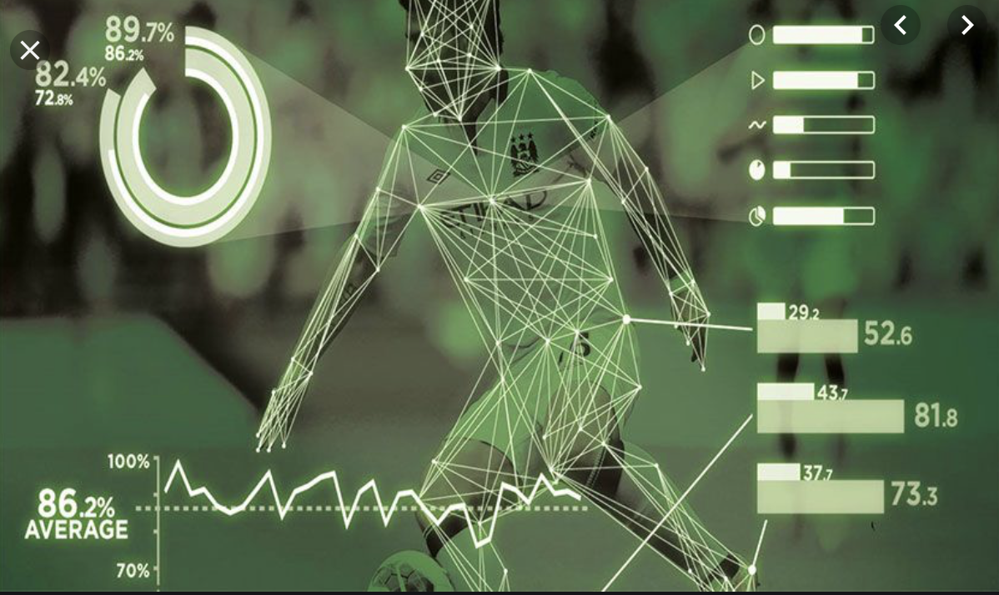
Business Case
Discover
Potentially suitable players suitable for the club
Monitor
Performance of new and existing players
Track
Growth and development of potential recruits
Notes:
As of now the scouts can only work on recruiting one player at a time and that makes the process of recruitment very slow. This might result in losing probable good bids. Scouts do not have access to an exhaustive list of criteria before doing preliminary selection of players. This causes conflict in decisions between different stakeholders of the process such as coaching staff, owners and managers of the club. After scout chooses a player following a preliminary criterion the process of assessment of players involves travelling to the player’s upcoming match locations and assessing the quality of the player. After a player is determined to satisfy the requirements of the club, the player and their current club are approached regarding the transfer of that player and a bid is placed. However, the selection of players without an optimized list makes the bidding process inefficient.
We need a system to discover potentially suitable players from a database and monitor their performance.
with many players and player statistics to consider, scouts need real-time information to help shortlist viable recruits and to make the case for their selection to management or rather the decision makers of the club.

Slide 4
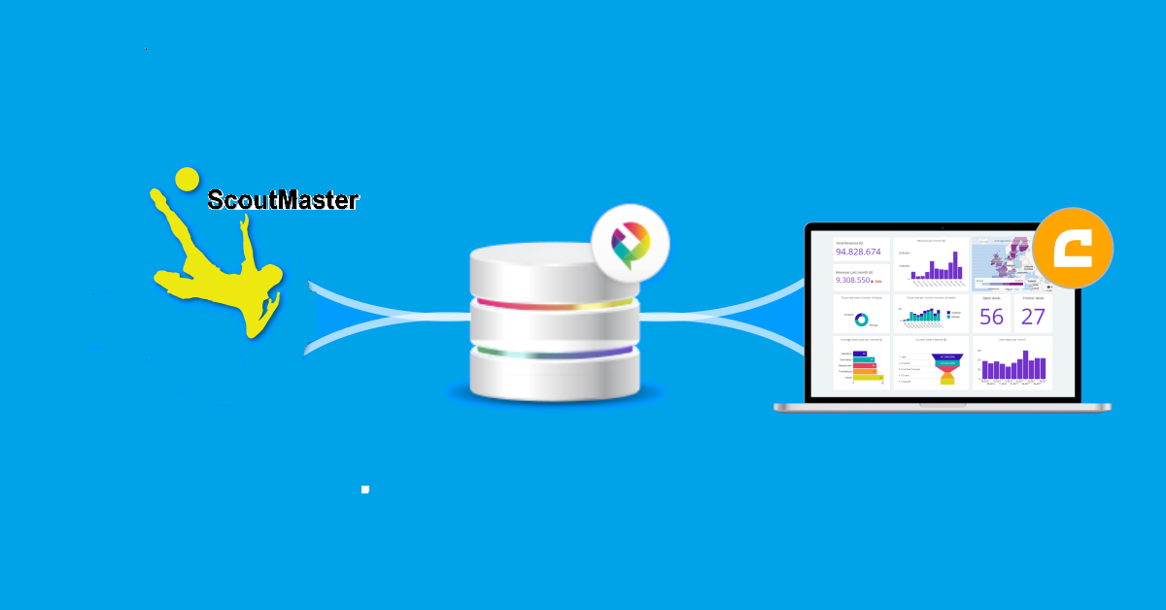
Notes:
ScoutMaster offers digital solution to increase the quality of player tracking and talent detection

Slide 5
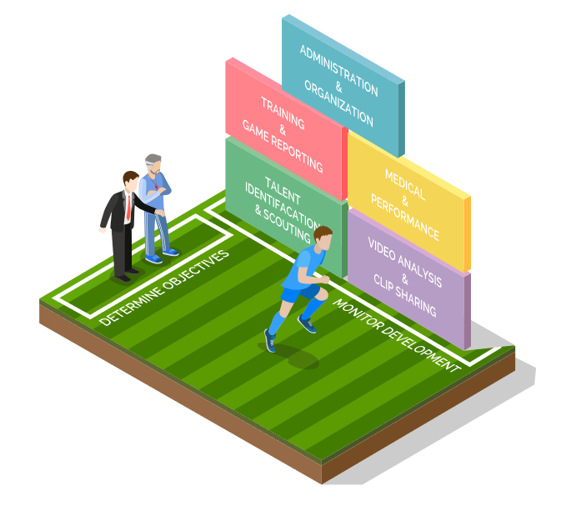
Key features
Notes:
One player monitoring tool
Tracks performance of players
Build up medical player history reports to keep track of player’s physical evolution and biometrics
Search for players using different filters and create your own player’s recruiting pipeline
Measures progress of a club

Slide 6
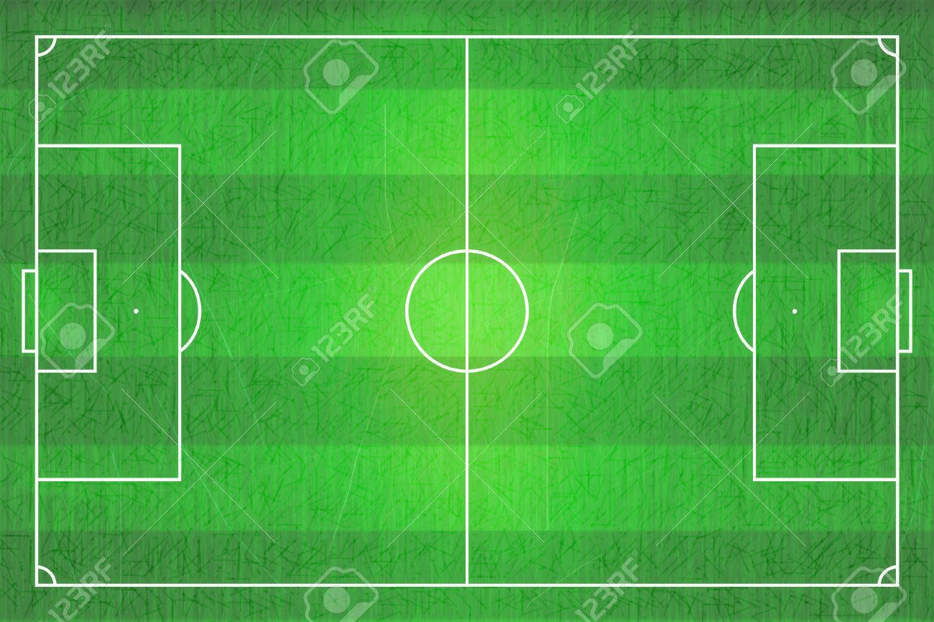



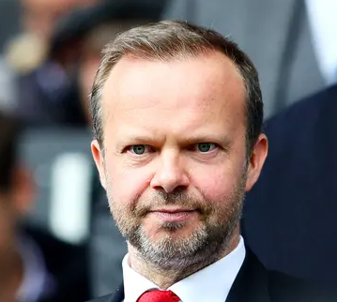


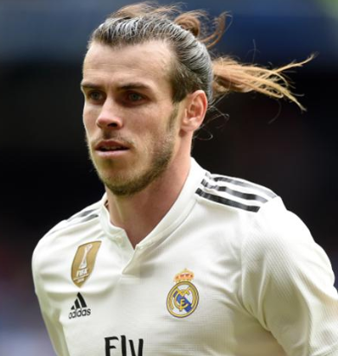

Team formation and strategy
Coaching
Request new player
Evaluate new selection
Scouts
Shortlist players
Evaluate players
Approach selection
Managers
Budgeting
Bidding & negotiations
Complete transfer
Leagues
Process supervision
Owner
Receive offers & negotiate
Players
Availability
Respond to interest
Personal terms
Medical evaluation
Medical

Slide 7
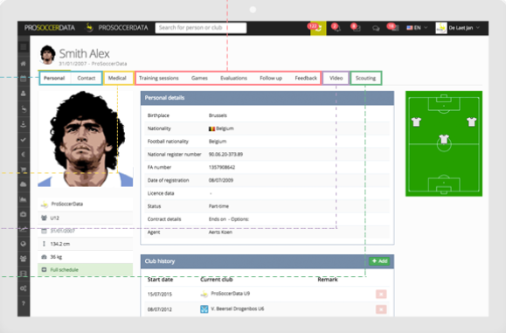
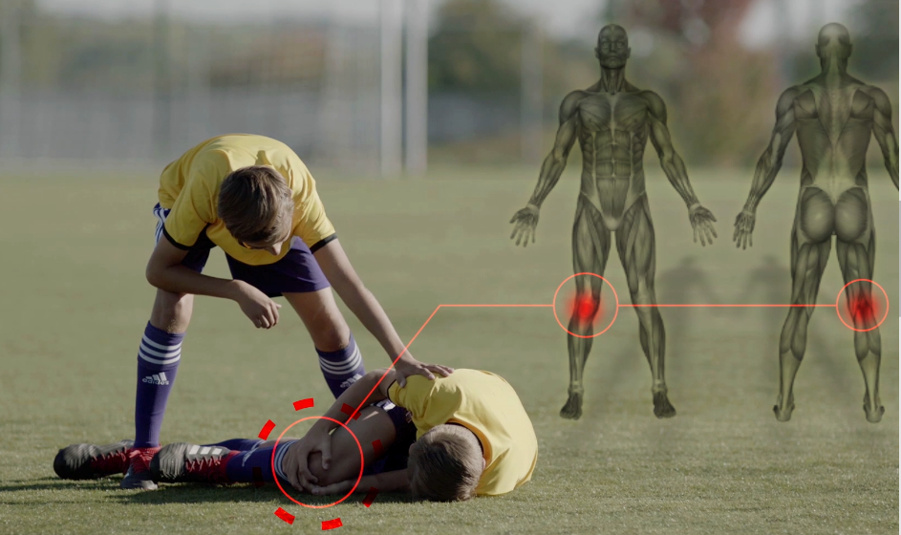

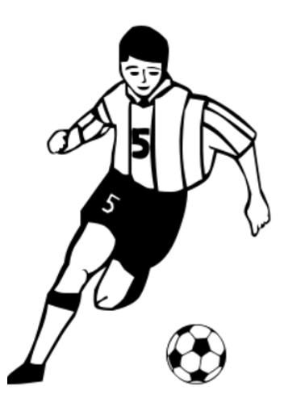
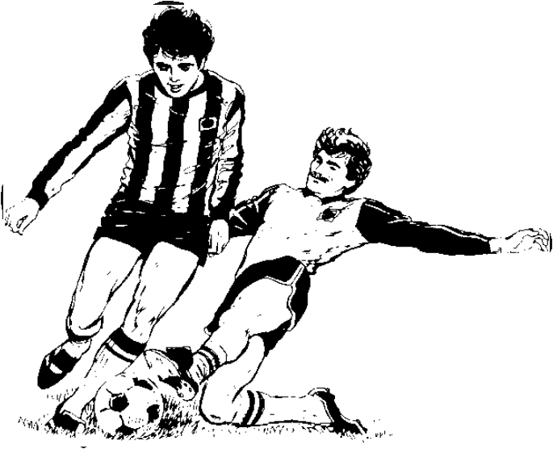

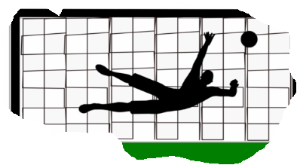

Soccer reporting
Notes:
Explain queries on clicking each picture
Now that you are aware of how ScoutMaster works and how each unit’s decision is associated with recruitment of a player, let’s look into some robust ScoutMaster reports.
Scouts will be able to customize these reports according to their requirements.
First report is about getting medical history of players – Scouts refer to this report to get the details of players who are fit to play. So , in the query you can see that we are getting the player details by joining 2 tables: medical history and players and restricting the query to get players whose med fit flag is set as ‘Y’
Second report is about Player’s performance stats and details- say Scouts want to get a list of players who are right wingers and below age 28 or say Scouts are looking for players whose existing contract will end in less than a year.
Third query helps Scouts to optimize player’s assessment plan by getting list of players playing for same league nation. This helps them to evaluate more players in a very short period of time or say if they have to cater to an immediate requirement.

Slide 8






Business Benefits
Planning
and
administration
Text Here
Easy to change colors.
Soccer reporting
Notes:
planning & administration:
Manage all your player & staff administration in one place. Helps in planning the recruitment process of players.
soccer reporting:
Create customized player evaluation forms using qualitative or quantitative variables.
Determine the level of game reporting details for your coaches and generate
interesting team statistics
medical& performance
Keep track of the medical status of your players by reporting doctor visits. Upload injury scans and decide who needs to get access to medical reports.
Scouting
Submit scouting reports and create a centralized scouting database on which you can apply specific skill filters. Helps in faster player assessment.

Slide 9
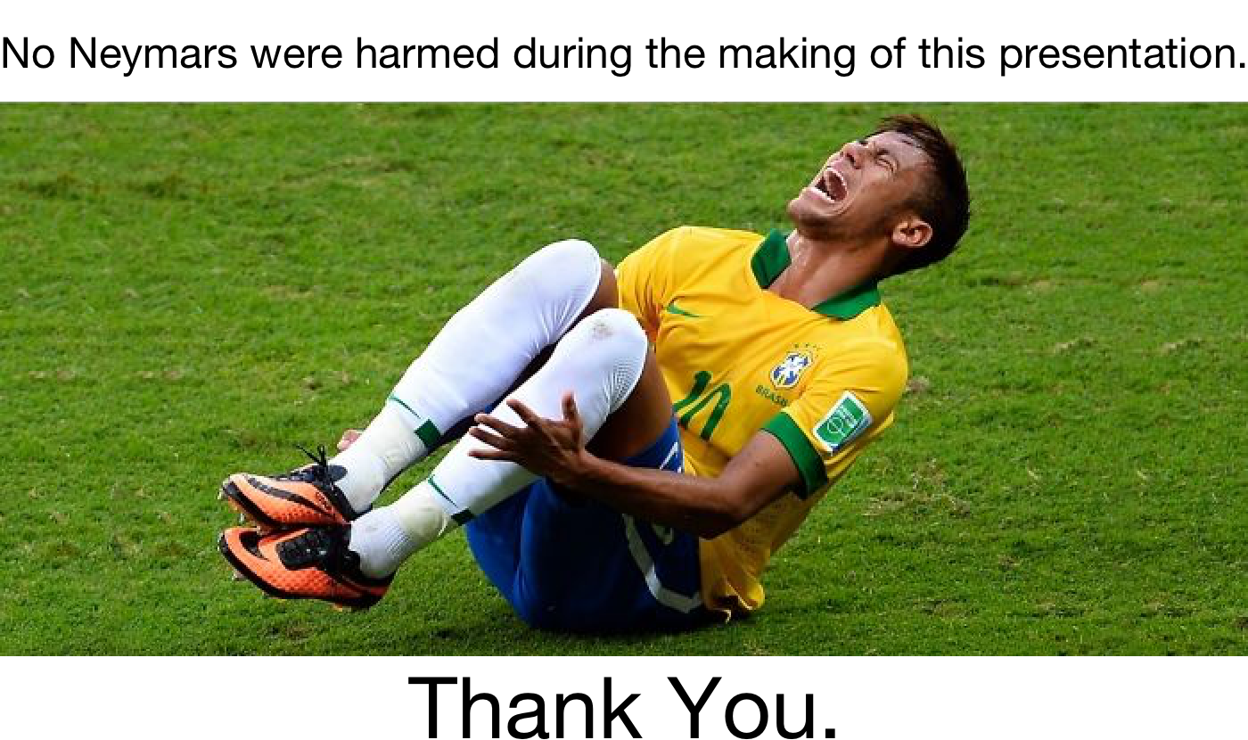

Slide 10
References
https://www.prosoccerdata.com/

